Slide 1
Developing the Risk and Opportunity Framework
E
Ongoing Research from the
UChicago Consortium
This slide deck breaks down the data system that Chicago schools now use to monitor freshman success. As the On-Track work evolved, UChicago Consortium researchers and the Network for College Success collaborated to develop a broader data framework to guide improvement efforts. Called the Risk and Opportunity Framework, it now functions as a detailed early warning indicator system for monitoring freshman success in schools throughout Chicago. Adopting this new and more complex data system also helped practitioners move from improving On-Track rates to increasing freshman course performance to higher levels.

Slide 2
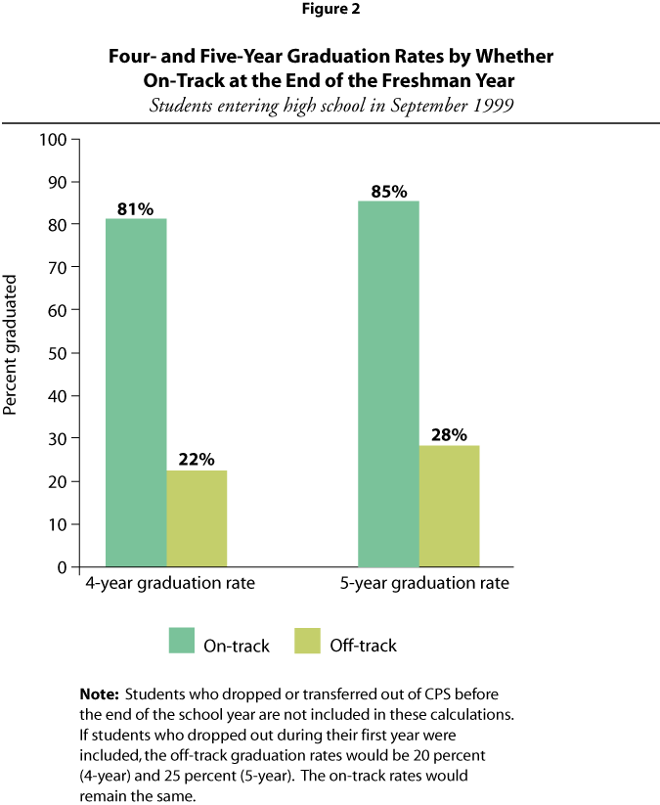
Prior to 2014, the UChicago Consortium identified two crucial indicators for freshman success: On-Track and Bs or Better. On-Track is an early indicator of high school graduation. UChicago Consortium research shows that On-Track students are four times more likely to graduate from high school than their off-track peers.

Slide 3
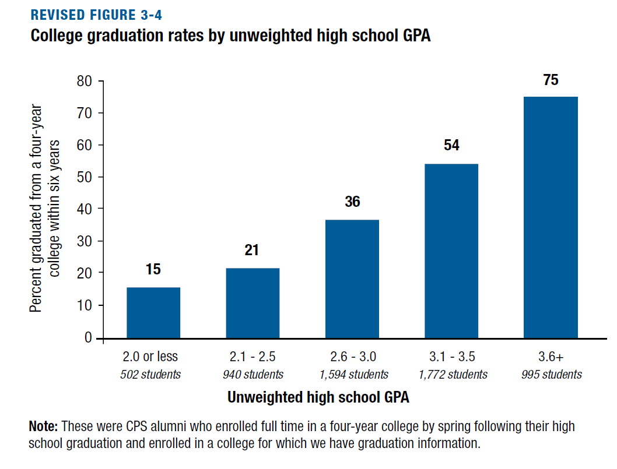
Bs or Better (meaning a student has a 3.0 GPA or better) is an important leading indicator of college readiness. In addition, students who earn above a 3.0 GPA in high school are more than 50% likely to graduate from college. Critically, high school GPA, not test scores, is the best predictor of college graduation.

Slide 4
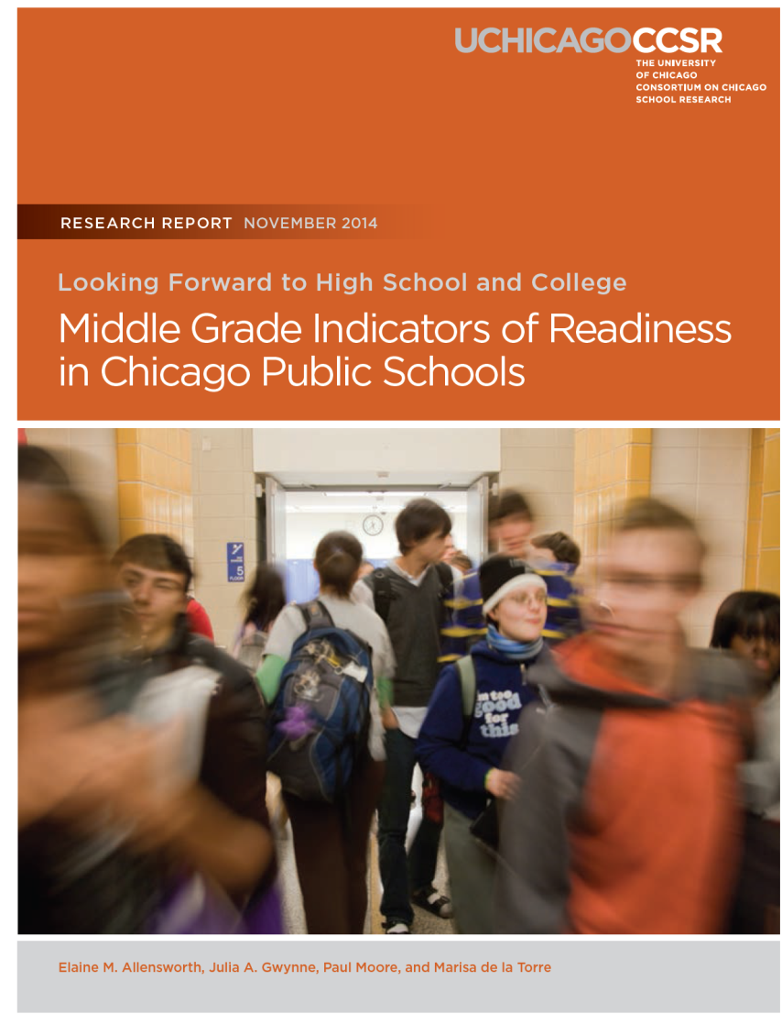
Ongoing Research from the
UChicago Consortium
In the summer of 2013, UChicago Consortium researchers began discussing the findings from the report, Looking Forward to High School and College: Middle Grade Indicators of Readiness in Chicago Public Schools with Network for College Success staff. This report included several critical pieces of new information around freshman year, including findings about talent loss among high-achieving students between 8th and 9th grade. UChicago Consortium researchers and Network for College Success staff began presenting these research findings and discussing their implications for practice at partner schools.

Slide 5
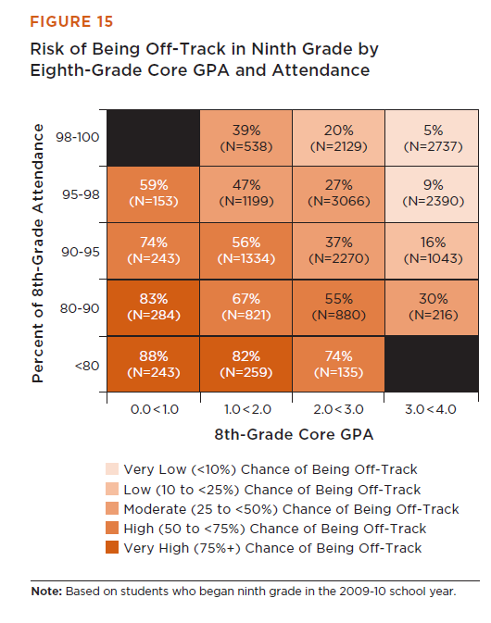
Ongoing Research from the
UChicago Consortium
The “Looking Forward” report included this table for considering the likelihood of Freshman On-Track status (and a similar table for the likelihood of earning a 3.0 GPA), given 8th grade attendance and GPA.

Slide 6
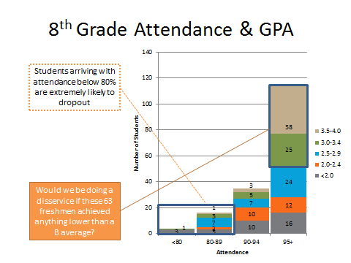
Ongoing Research from the
UChicago Consortium
In the fall of 2013, with support from Network for College Success staff under a Federal School Improvement Grant, Hancock High School used this table to group incoming freshmen, pushing staff to support students to achieve “Bs or Better.”

Slide 7
Ongoing Research from the
UChicago Consortium
Defining “Risk and Opportunity” for 9th Grade Success
8th Grade Core GPA
 | 0-1.0 | 1.0-2.0 | 2.0-3.0 | 3.0-4.0
≥ 98% |  |  | Opportunity | High Opportunity
≥ 95% |  | Vulnerable
≥ 90%
≥ 80% | High Risk
<80%
Network for College Success Data Strategists and UChicago Consortium researchers turned the table from the “Looking Forward” report into the Risk
and Opportunity Framework, a case management tool that schools could
use with their real-time data.
8th Grade Attendance

Slide 8
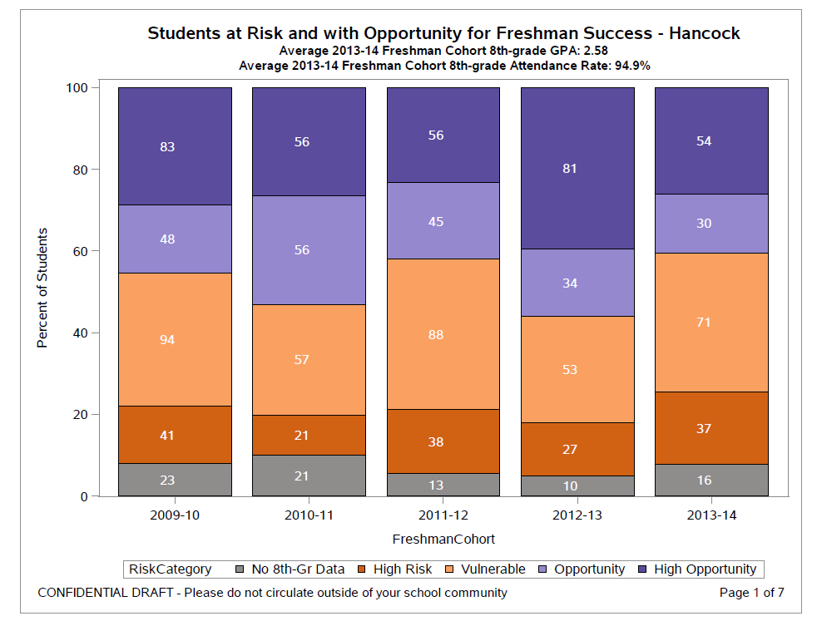
Ongoing Research from the
UChicago Consortium
As schools like Hancock began to use the Risk and Opportunity Framework in real time, UChicago Consortium researchers designed reports to show trends within the various schools.

Slide 9
Ongoing Research from the
UChicago Consortium
First distributed in the fall of 2014, the new trend reports included not just On-Track and off-track status, but a status category for “Bs or Better.”

Slide 10
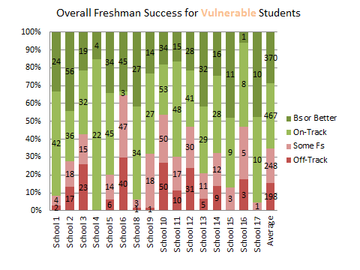
Ongoing Research from the
UChicago Consortium
Also in 2014, the Network for College Success began holding quarterly Performance Management sessions on freshman success for partner school leaders.

Slide 11
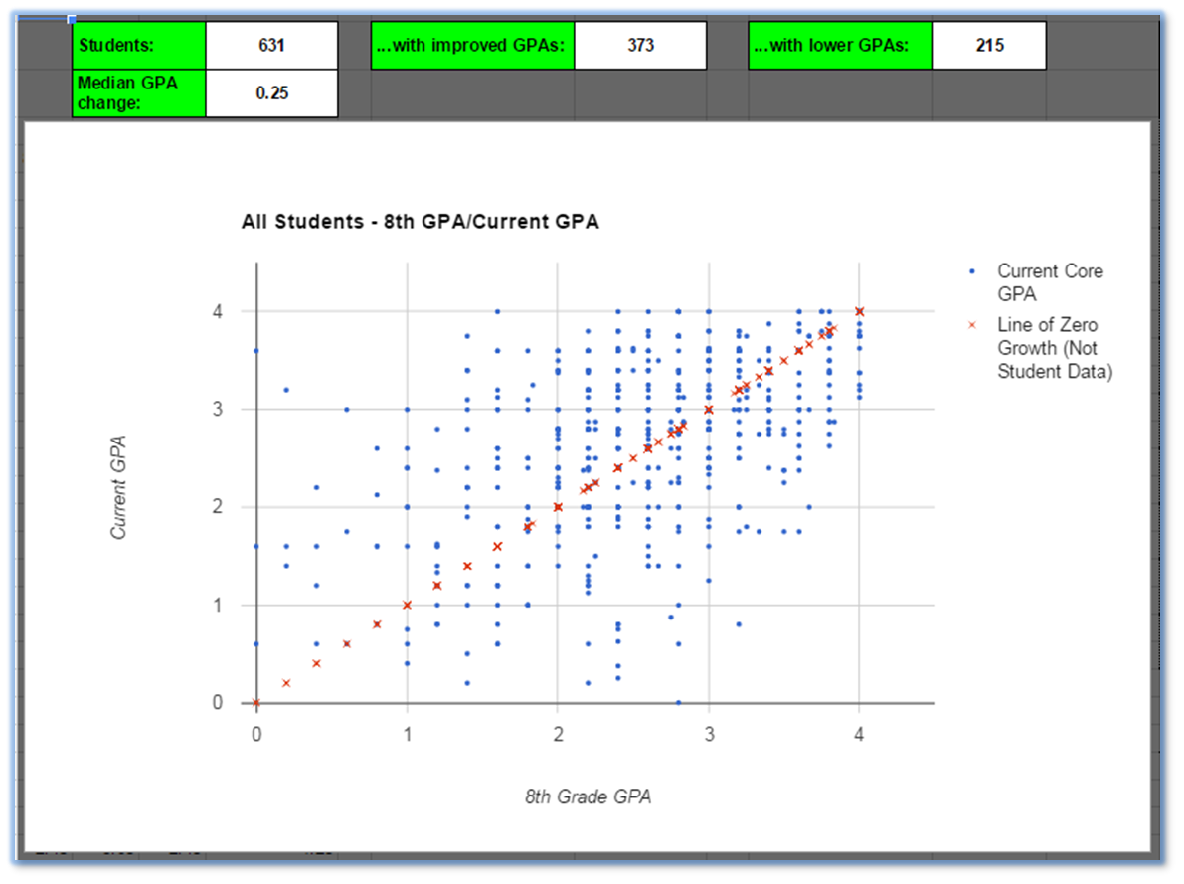
Ongoing Research from the
UChicago Consortium
Network for College Success Data Strategists built tools to be used in schools to manage freshman success data as well as guide practice and interventions between the Performance Management sessions.

Slide 12
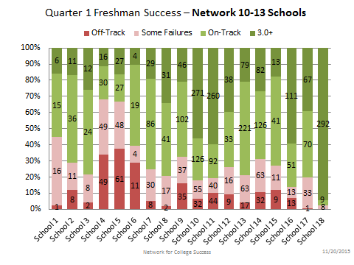
Ongoing Research from the
UChicago Consortium
In school year 2015-16, the Network for College Success expanded quarterly Performance Management sessions to all 99 high schools in the city, serving an additional 350 educators.

