Slide 1
Findings from the UChicago Consortium on School Research on College Access and Success

Slide 2
Overview
Brief background on the UChicago Consortium, the post-secondary transition research project, and Chicago Public Schools (CPS)
Three main findings on critical leverage points to college access and success for underrepresented students

Slide 3
Background on the UChicago Consortium’s Multi-Year Research Project
Close collaboration between a team of researchers at the UChicago Consortium and the CPS Office of College and Career Success, beginning in 2004
Work on a common set of problems around college access and college completion
Gap between college aspirations and college completion
Rich data archive on CPS, including student administrative records, course transcripts, test scores, student and teacher surveys, National Student Clearinghouse data, and CPS Senior Exit Questionnaire
Accompanied by qualitative research

Slide 4
How do we study the college application and college search process in CPS?
Quantitative: CPS Postsecondary Tracking System (close look at 2005 graduates)
2005 Consortium senior surveys
Senior Exit Questionnaire
NSC data with corrections for schools not participating in NSC
Qualitative: A longitudinal study of 105 students in three high schools (class of 2006)
Students interviewed two times junior year, three times senior year– followed through two years post high school
All students coded for main patterns of application and enrollment; Qualitative cases and thematic analysis used in the report

Slide 5
Critical Leverage Points on the Path to College: What Does the Research Say?

Slide 6
Critical Leverage Points
Getting to college requires social capital and “college knowledge.”
Filing a FAFSA increases the likelihood of four-year college enrollment.
College choice matters a great deal for college completion.
A high school’s college-going culture has significant impact on students’ ability to navigate the postsecondary pipeline.
Increasing student qualifications is the single-most important strategy of getting CPS graduates to and through college.

Slide 7
#1: Getting to college requires social capital and “college knowledge.”
Like students in other urban areas, a great majority CPS students are first generation college-going students and need structured support in the college search and application processes.

Slide 8
Potholes on the Road to College

Slide 9
While Many Kinds of Capital are Important, Potholes Identified the Critical Role of Social Capital
Human Capital
Qualifications
Financial Capital
College costs, including tuition, housing, books, etc.
Social Capital
Norms for college, college information, concrete guidance, and support from families, communities and schools
Notes:
Potholes report

Slide 10
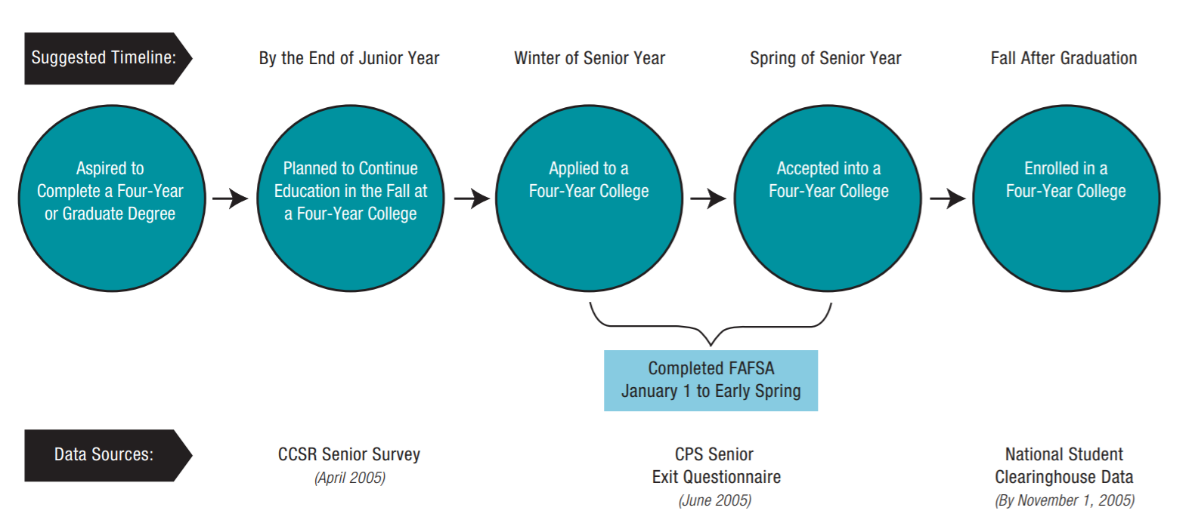
Researchers Followed Students Along a Series of College Planning Decision Points

Slide 11
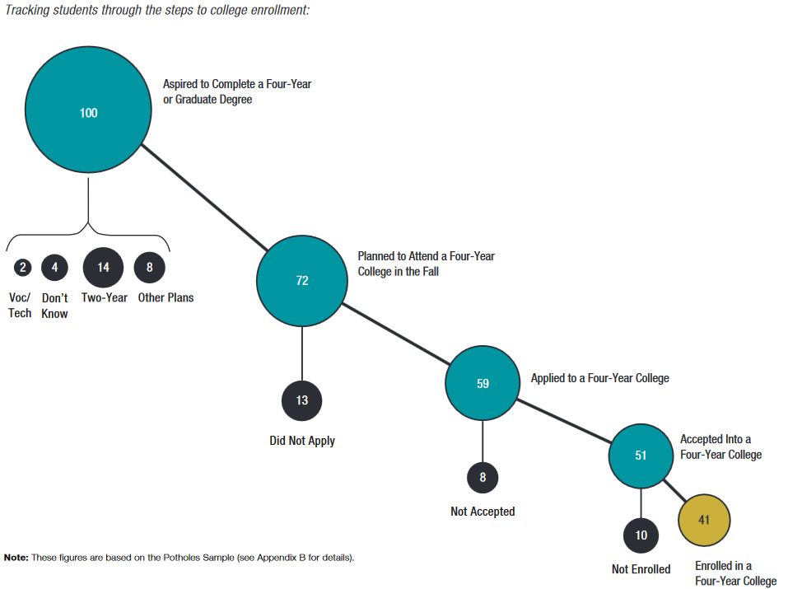
Only 41 Percent of CPS Graduates Who Aspired to Complete a Four-Year Degree Took These Steps
Notes:
1a
Sub-points: selective access kids; Latino kids

Slide 12
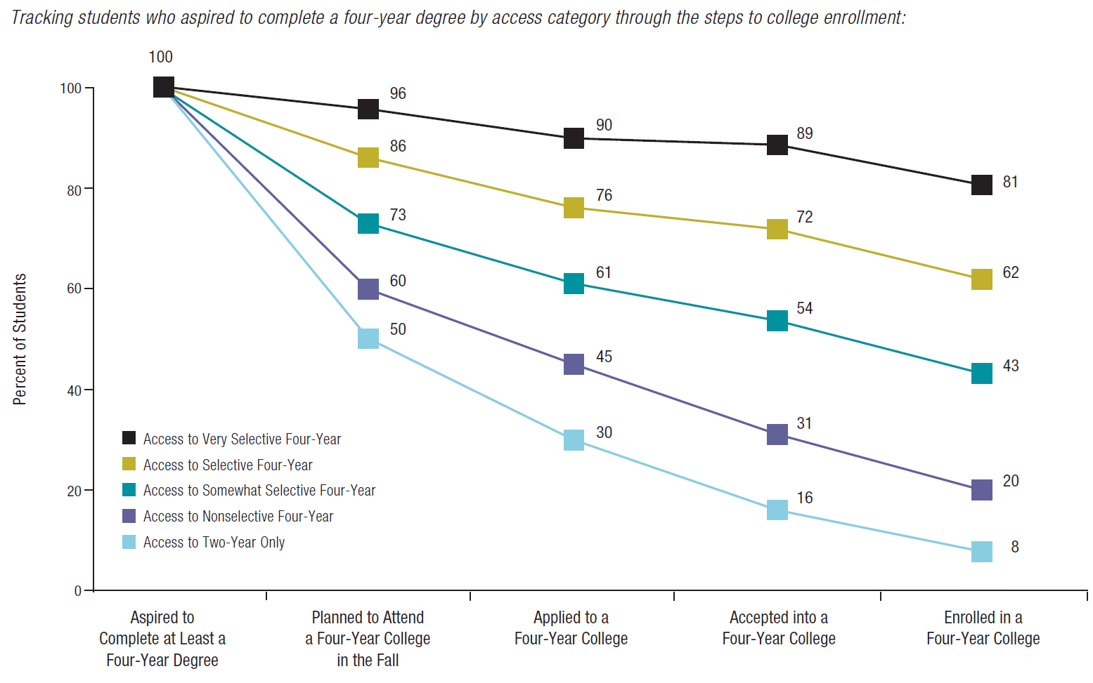
Only 61 Percent of Students Qualified to Attend a Somewhat-Selective College Applied

Slide 13
Why do so Many Students Take Themselves out of the College Search Process so Early?
Positive press for college from parents and teachers, but a lack of structured support and concrete guidance that helps students organize their information and manage the process
Sticker shock: Students fear college costs and a lack of information on how financial aid can make college more affordable
Risk aversion: Students fear making the wrong college decision and do not feel that they know how to make the right one
Opting out or making decisions that feel safe based on seemingly random, uninvestigated, or even incorrect information or advice

Slide 14
#2: Filing a FAFSA increases the likelihood of four-year college enrollment.
Applying for financial aid may be the most critical step on the road to college for low-income students and it is also the most confusing.
Not filing a FAFSA is a significant barrier to college enrollment for CPS students.

Slide 15
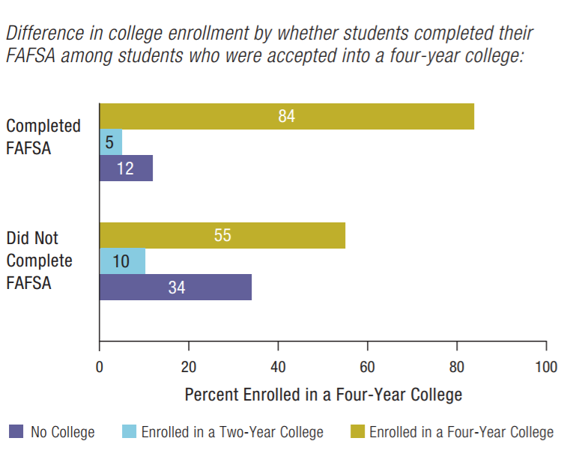
Students Accepted into a Four-Year College Were Much More Likely to Enroll if They Completed the FAFSA

Slide 16
How does FAFSA affect college choice?
Students who were accepted to a four-year college and filed a FAFSA were over 50 percent more likely to enroll than students who did not complete a FAFSA by the spring.
Only 59 percent of students who enrolled in a two-year college stated that they filed their FAFSA by the spring, compared to the 84 percent who attended a four-year college.
Students who made early decisions to go to two-year colleges without filing a FAFSA were making college decisions without comparing “real” options.

Slide 17
#3: College choice matters a great deal.
Colleges vary widely in their institutional graduation rates, even among colleges of similar selectivity.
Students often lack the information and support needed to make well-informed college choices.
Many students enroll in colleges that are below the level of selectivity to which their qualifications give them access (undermatching).

Slide 18
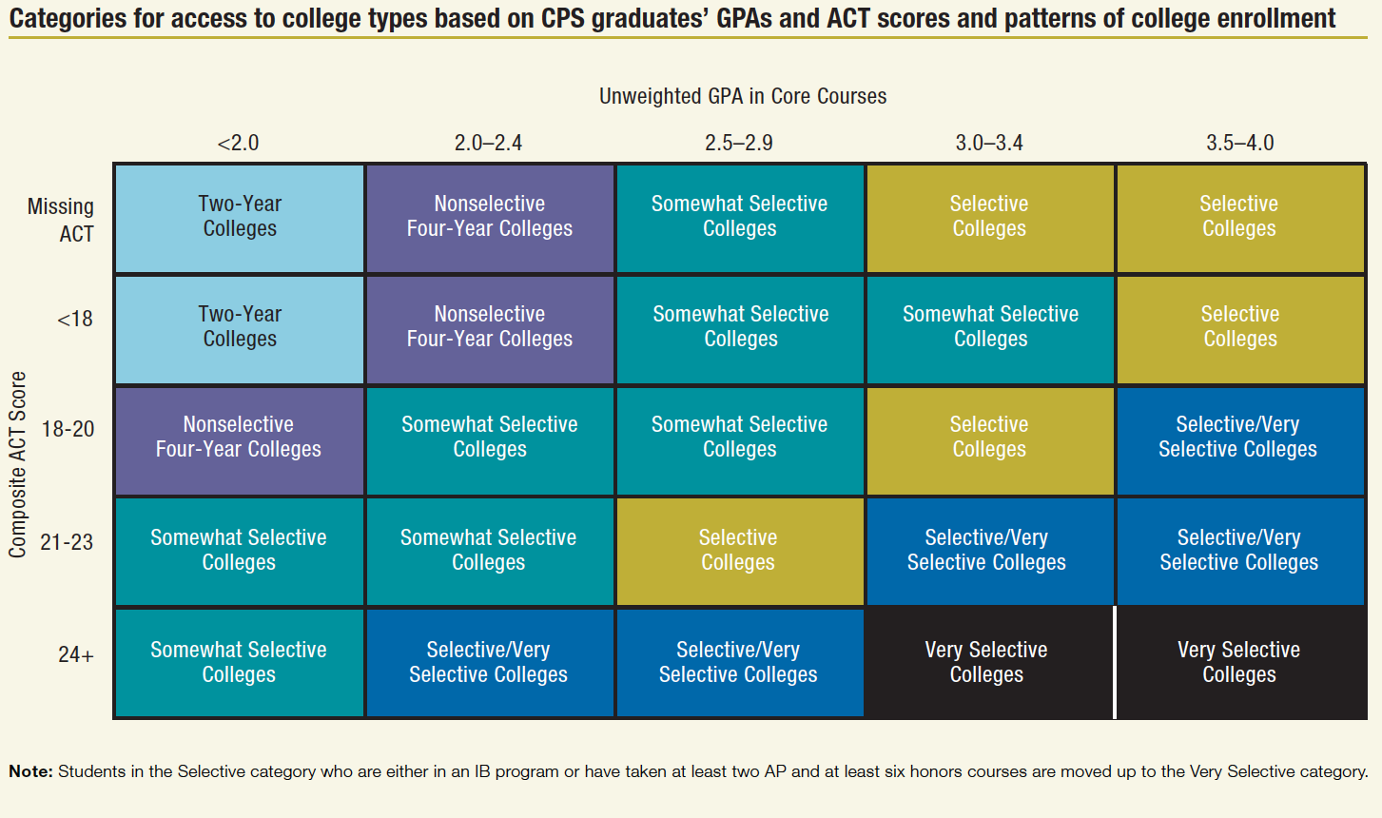
Determining Access to College
From High School to the Future: Potholes on the Road to College (2008)
Roderick, Nagaoka, Coca, and Moeller

Slide 19
College Match and Fit
College Fit: The extent to which an institution meets a student’s social, academic, and financial needs. Considerations of fit may be based on a variety of factors, including location, academic programs and majors, class sizes, graduation, employment rate and, support services.
College Match: Refers to the relationship between institutional selectivity and students’ academic qualifications; usually assessed by GPA and standardized test scores (e.g., ACT/SAT). Students often use “match” to assess their chances of being admitted to a particular institution and to determine where they will apply.
Notes:
Roderick, Melissa, Jenny Nagaoka, Vanessa Coca, and Eliza Moeller. 2009. From High School to the Future: Making Hard Work Pay Off. Chicago, IL: Consortium on Chicago School Research.

Slide 20
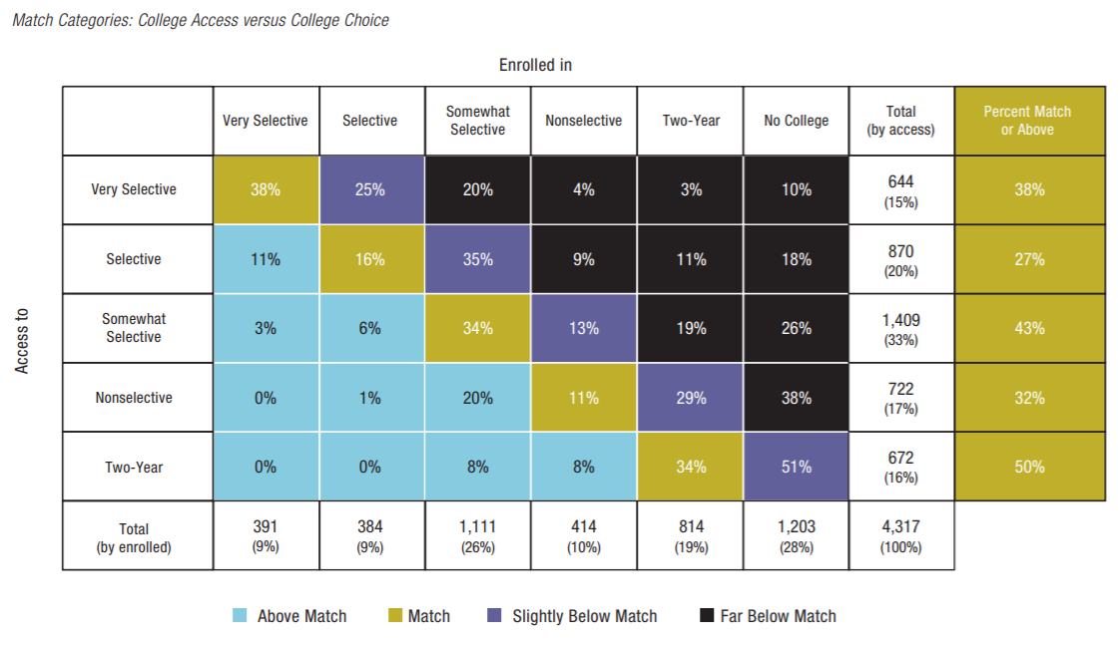
Academic “Undermatch” is Common Among Students Highly Qualified for College
From High School to the Future: Potholes on the Road to College (2008)
Roderick, Nagaoka, Coca, and Moeller

Slide 21
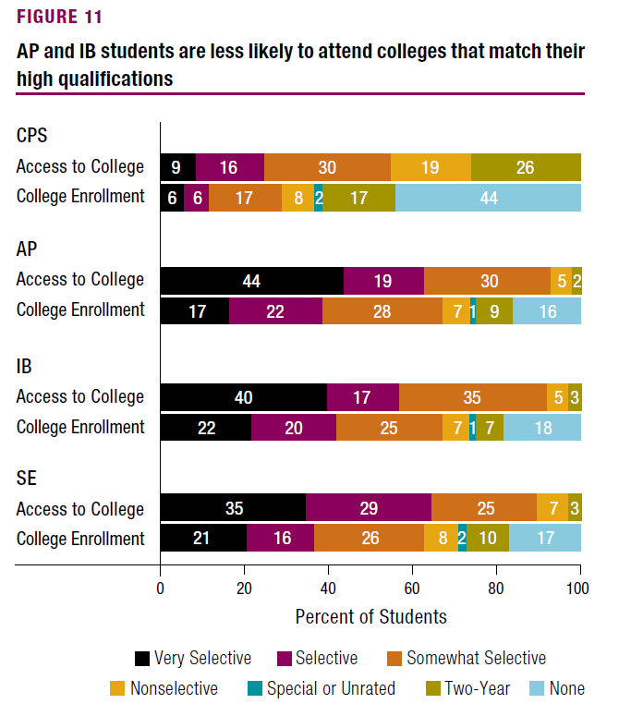
Many Academically-Talented Students Enroll in “Undermatch” Colleges

Slide 22
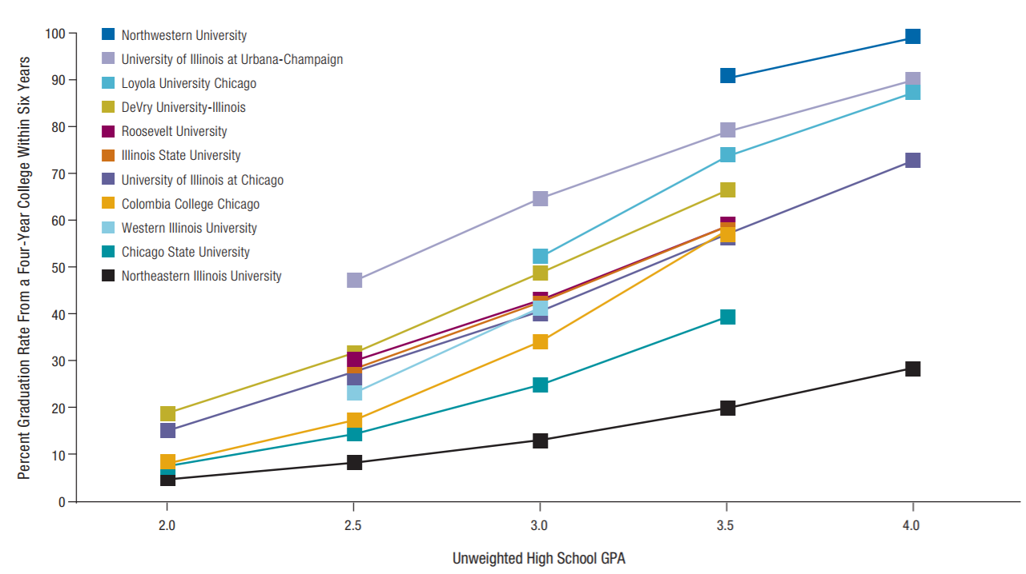
Choosing an “Undermatch” College Could Hurt Students’ Chance of Graduating
From High School to the Future: Potholes on the Road to College (2008)
Roderick, Nagaoka, Coca, and Moeller

Slide 23
#4: The college-going culture of a high school can have a significant impact on the college outcomes of its graduates.
Barbara Schneider defines college-going climate as the
…shared goals among the staff that all students can go to college and it is their personal responsibility to try and make this happen (2007).

Slide 24
College-Going Culture Measure from the UChicago Consortium’s Annual Survey of Chicago Teachers
Do you agree or disagree with the following statements:
Teachers in this school expect most students to go to college.
Teachers help students plan for college outside of class time.
The curriculum at this school is focused on helping students get ready for college.
Teachers feel that it is a part of their job to prepare students to succeed in college.
Many of the students in this school are planning on going to college.

Slide 25
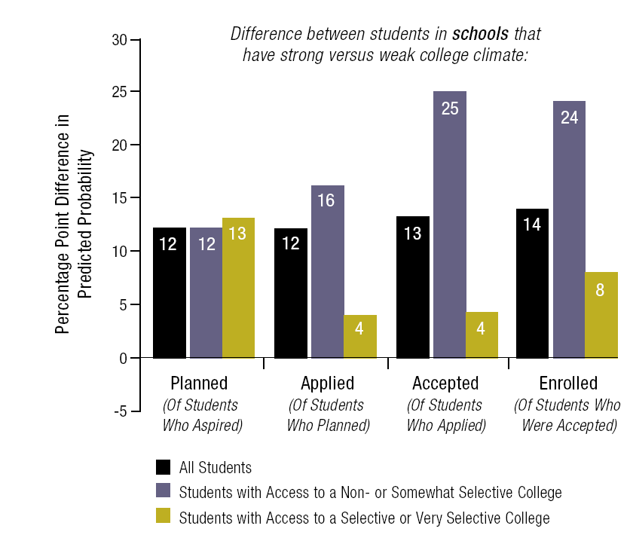
The Most Consistent School Predictor of Taking Steps toward College Enrollment is Strong College Climate
From High School to the Future: Potholes on the Road to College (2008)
Roderick, Nagaoka, Coca, and Moeller

Slide 26
#5: Increasing student’s GPA is the single most important strategy for improving CPS graduates’ likelihood of getting to and through college.
While ACT/SAT test scores limit the number of college options students have, UChicagoConsortium research shows that student GPA is a better indicator of students’ future performance, such as college persistence and completion

Slide 27
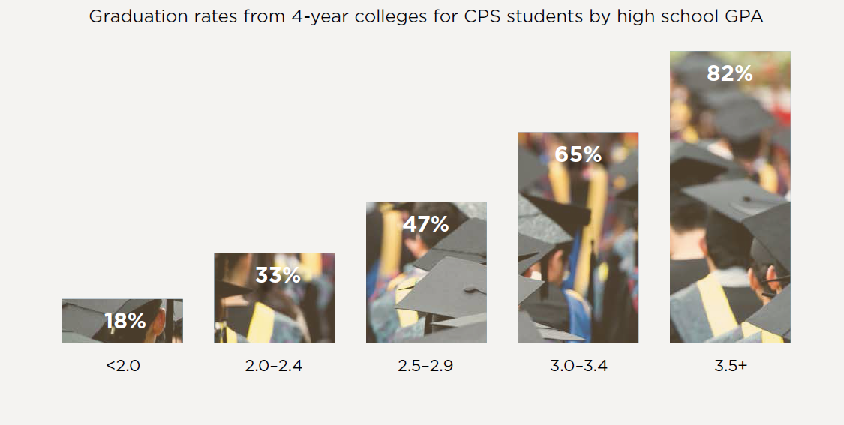
Ultimately, a Higher High School GPA Increases the Odds of Making it Through College

Slide 28
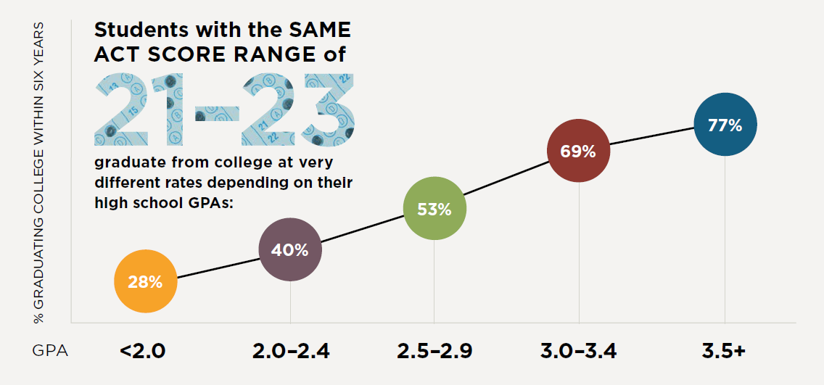
GPAs Are the Strongest Predictor of College Graduation

Slide 29
Advanced Coursework Can Make a Difference
Students who participate in the International Baccalaureate Programme are more likely to enroll in a four-year college, enroll in a selective or very selective college, and persist in college.
Taking other advanced coursework in senior year (like Advanced Placement or higher-level math courses) can have a positive effect on four-year college enrollment and selective college enrollment for some students.

